Slide 1


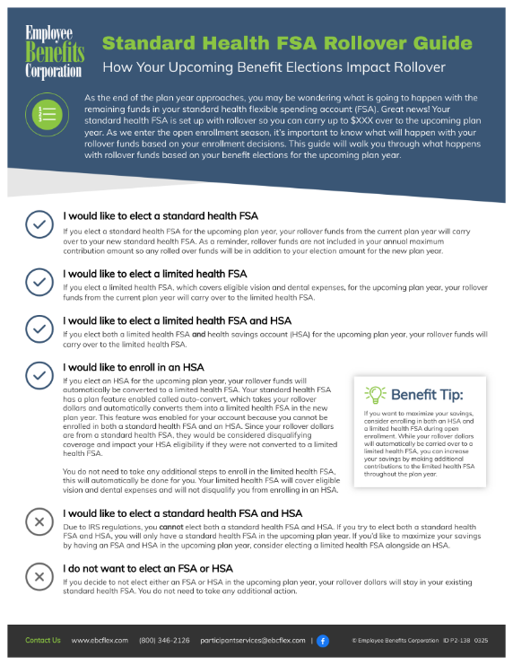

Instructions
Please ensure that you fill in your rollover amount (A) and delete these instructions before sharing the flyer with your employees. This flyer is only intended for clients who offer FSAs and HSAs from EBC and have auto-convert set up for their standard health FSA.
A

Slide 2










Standard Health FSA Rollover Guide
How Your Upcoming Benefit Elections Impact Rollover
As the end of the plan year approaches, you may be wondering what is going to happen with the remaining funds in your standard health flexible spending account (FSA). Great news! Your standard health FSA is set up with rollover so you can carry up to $XXX over to the upcoming plan year. As we enter the open enrollment season, it’s important to know what will happen with your rollover funds based on your enrollment decisions. This guide will walk you through what happens with rollover funds based on your EBC benefit elections for the upcoming plan year.
As a reminder, rollover funds are not included in your annual maximum contribution amount, so any rolled over funds will be in addition to your election amount for the new plan year.
I would like to elect a standard health FSA
If you elect a standard health FSA for the upcoming plan year, your rollover funds from the current plan year will carry over to your new standard health FSA.
I would like to elect a limited health FSA
If you elect a limited health FSA for the upcoming plan year, which covers eligible vision and dental expenses, your rollover funds from the current plan year will carry over to the limited health FSA.
I would like to elect a limited health FSA and contribute to* an HSA
If you elect a limited health FSA and choose to contribute to* a health savings account (HSA) for the upcoming plan year, your rollover funds will carry over to the limited health FSA.
I would like to contribute to* an HSA
If you choose to open and contribute to an HSA from EBC** for the upcoming plan year, your rollover funds will automatically be converted to a limited health FSA. Your standard health FSA has a plan feature enabled called auto-convert, which takes your rollover dollars and automatically converts them into a limited health FSA in the new plan year. This feature was added to your plan because if your rollover dollars carry over to a standard health FSA, they will disqualify you from contributing to* an HSA in the new plan year.
You do not need to take any additional steps for unused funds to roll over into a limited health FSA. This will automatically be done for you. Your limited health FSA will cover eligible vision and dental expenses and will not disqualify you from contributing to* an HSA.
Benefit Tip:
If you anticipate eligible dental or vision expenses in the new year and want to maximize your savings, consider enrolling in both an HSA and a limited health FSA during open enrollment. While your rollover dollars will automatically be carried over to a limited health FSA, you can increase your savings by making additional contributions to the limited health FSA throughout the plan year.
I would like to elect a standard health FSA and contribute to* an HSA
Due to IRS regulations, you cannot elect both a standard health FSA and contribute to* an HSA. If you elect a standard health FSA, your standard health FSA would disqualify you from contributing to* an HSA in the upcoming plan year. If you’d like to maximize your savings by having an FSA and HSA in the upcoming plan year, consider electing a limited health FSA alongside contributing to an HSA.
I do not want to elect a health care FSA or contribute to an HSA
If you decide to not elect an FSA or contribute to* an HSA in the upcoming plan year, your rollover dollars will stay in the health care FSA account type (standard or limited) you have today. You do not need to take any additional action.
*Contributions include any employee contributions and, if applicable, any employer contributions to the HSA.
**You must inform your employer of your intent to make HSA contributions prior to the first day of the plan year.
Contact Us www.ebcflex.com (800) 346-2126 participantservices@ebcflex.com |
© Employee Benefits Corporation ID P2-139 0325

