Slide 1



Health Savings
Account
© Employee Benefits Corporation

Slide 2

IMPORTANT INSTRUCTIONS
THIS IS A CUSTOMIZABLE PRESENTATION. Please carefully review the information and fill in the placeholder slots in the slides as it applies to your plan.
Specifically, review the following:
Employer Contribution Slide: If you're contributing to your employees' HSA, fill in your company name on this slide and add the contribution amount for single and family. If you aren't contributing, feel free to delete this slide.
Consolidating Account Slide: If you haven't offered an HSA before, you may want to remove this slide to avoid confusion. However, your employees may have an HSA from a previous employer, so you may want to provide the information on consolidation to provide a streamlined benefits experience.
Once you're done customizing the slides, please delete this instruction slide prior to presenting.

Slide 3



A savings account that lets you set aside money on a pre-tax basis to pay for qualified medical expenses. Employees and employers may both contribute funds to the account, and the employee owns the account.
What is a
Health Savings Account?
© Employee Benefits Corporation

Slide 4



HSA ELigibility
To contribute to an HSA, you must meet the following four criteria:
01.
02.
BE ENROLLED IN AN HSA-QUALIFIED HIGH DEDUCTIBLE HEALTH PLAN (HDHP)
This must meet minimum annual deductible and maximum out-of-pocket limits established by the IRS.
NOT BE COVERED BY ANY DISQUALIFYING COVERAGE, INCLUDING A STANDARD HEALTH FSA
This refers to any coverage that reimburses for general medical expenses before a minimum deductible is met.
03.
04.
Not be another individual's tax dependent
Not be enrolled in Medicare
© Employee Benefits Corporation

Slide 5


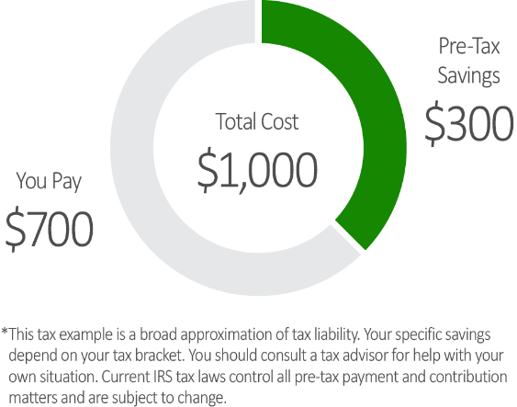

HSA Savings
tax savings on eligible purchases
With an HSA, you save approximately 30%* on your eligible expenses when you contribute through a cafeteria plan, making a $1,000 expense cost you about $700.
© Employee Benefits Corporation

Slide 6





2025 HSA CONTRIBUTION LIMITS
YOU choose how much of YOUR pay to place in the hsa*
(up to the IRS Maximum)
SINGLE
FAMILY
$4,300
$8,550
ANNUALLY
ANNUALLY
*Limits are based on the assumption that an individual is HSA eligible for the full plan year. Limits may be prorated based on the duration of HSA eligibility.
$1,000 catch-up contribution for individuals age 55+
$1,000 catch-up contribution for individuals age 55+
© Employee Benefits Corporation

Slide 7
2026 HSA CONTRIBUTION LIMITS
YOU choose how much of YOUR pay to place in the hsa*
(up to the IRS Maximum)
SINGLE
FAMILY
$4,400
$8,750
ANNUALLY
ANNUALLY
*Limits are based on the assumption that an individual is HSA eligible for the full plan year. Limits may be prorated based on the duration of HSA eligibility.
$1,000 catch-up contribution for individuals age 55+
$1,000 catch-up contribution for individuals age 55+
© Employee Benefits Corporation

Slide 8







ABC COMPANY'S CONTRIBUTIONS
SINGLE
FAMILY
Our contributions count towards your HSA maximum annual contribution limit.
$X,XXX
$X,XXX
© Employee Benefits Corporation

Slide 9






ROAD TO FINANCIAL WELLNESS
USE YOUR HSA TO SPEND, SAVE, OR INVEST YOUR FUNDS
SPEND
SAVE
INVEST
Use funds on a tax-free basis to pay for eligible purchases as they come up. For more information on where you can spend your HSA funds, visit ebcflex.com/WheretoShop.
Put funds away for future expenses. Take advantage of a high-yield HSA, which gives you the potential of a higher interest rate.
Help support your financial wellness by investing funds for
health emergencies or health costs incurred in retirement.
© Employee Benefits Corporation

Slide 10





Savings options
earn interest on your balance tax-free
You're free to switch between the default, traditional HSA and a high-yield HSA at any time, as frequently as desired.
High-Yield HSA
Traditional HSA
A high-yield HSA offers the potential to earn higher interest than a traditional HSA offers.
This is the default account you receive when you first enroll in your HSA.
© Employee Benefits Corporation

Slide 11





3 unique Investment models
Enjoy an innovative and modern investment experience that provides access to different investment account types, real-time investment account opening and trading, and modern investment tools.
Managed
Investment Opportunities
Self-Directed
HSA dollars can be invested when the account has a minimum balance of $1,000.
Brokerage
© Employee Benefits Corporation

Slide 12



Managed
Designed for novice investors who prefer to have our advisor tool automatically select and rebalance investments on an ongoing basis in accordance with their age and/or risk profile. This account type delivers a “do-it-for-me” approach to investing.
© Employee Benefits Corporation

Slide 13


Self-directed
Designed for intermediate investors who have the desire to self-select from a menu of monitored investment options covering multiple asset classes to diversify their portfolio, and then rebalance their portfolio manually. This account type provides a balance between do-it-for-me and DIY approaches to investing.
© Employee Benefits Corporation

Slide 14

Brokerage
Designed for adept investors who desire to perform advanced research and trading across hundreds of individual stocks and ETFs. This account type offers a hands-on, DIY approach to investing.
© Employee Benefits Corporation

Slide 15







Portability
HSA funds are portable. If you leave your employer, you keep the money in your account.
Withdrawing Funds
Once you incur an eligible expense, you can withdraw funds tax-free.
The expense must be incurred after the HSA is established.
You are able to withdraw up to the amount that is in your account
at the time of the request.
USING YOUR HSA DOLLARS
Pay for Eligible Expenses
There are multiple ways to access your HSA funds.
Benefits Card
Bill Pay Feature
accessing your funds is easy.
© Employee Benefits Corporation
accessing your funds is easy.

Slide 16

HSA EXPENSES
VISIT WWW.EBCFLEX.COM/ELIGIBLEEXPENSES FOR A MORE COMPREHENSIVE LIST
Dental expenses
Lab exams/tests
Vision expenses
Medical treatments / procedures
Copays, coinsurance, deductible expenses
Over-the-counter (OTC) medications and products
Medical supplies and services
© Employee Benefits Corporation

Slide 17




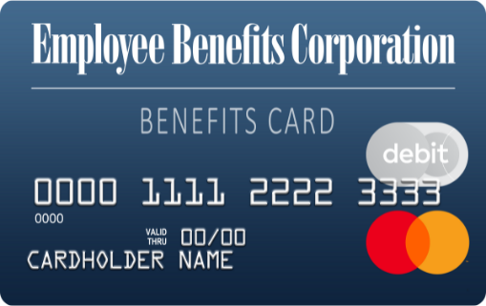


USING YOUR BENEFITS CARD
Swipe, Tap, or Type
Simply swipe the card, use it to pay online, or add it to your digital wallet* and use it wherever Apple Pay®, Google Pay, and Samsung Pay are accepted.
Where to Shop
Shop where you normally do, or check out an online retailer that specializes in FSA-eligible products. Visit ebcflex.com/WheretoShop to learn more.
Request Additional Cards
Request up to five additional cards for eligible users through your online account or the EBCentral app.
*Only available to primary cardholders
Apple® and Apple Pay® are registered trademarks of Apple Inc.
Google Pay is a trademark of Google LLC.
Samsung and Samsung Pay are trademarks of Samsung Electronics Co., Ltd.
© Employee Benefits Corporation

Slide 18

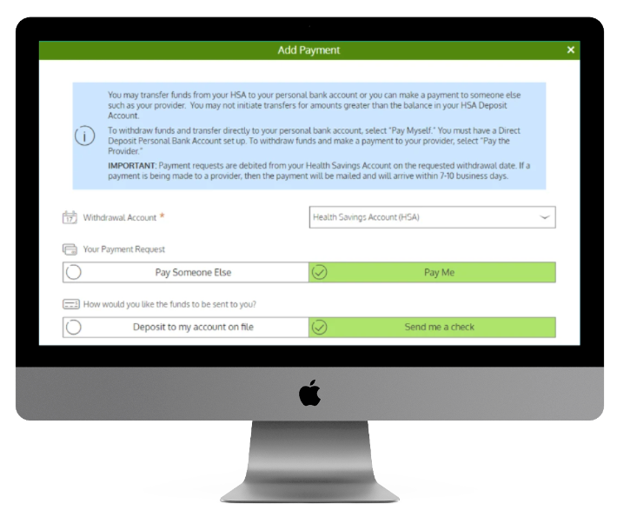

BILL PAY
Make one-time or recurring payments to any provider via check or electronic payment.
Log in to your account at www.ebcflex.com
Select View Balance > Pay with My HSA > Bill Pay > Pay Someone Else
You can also pay with your preferred method and repay yourself for an eligible expense through the HSA Bill Pay Feature. Follow the steps above and select "Pay Me" instead of "Pay Someone Else".
© Employee Benefits Corporation

Slide 19
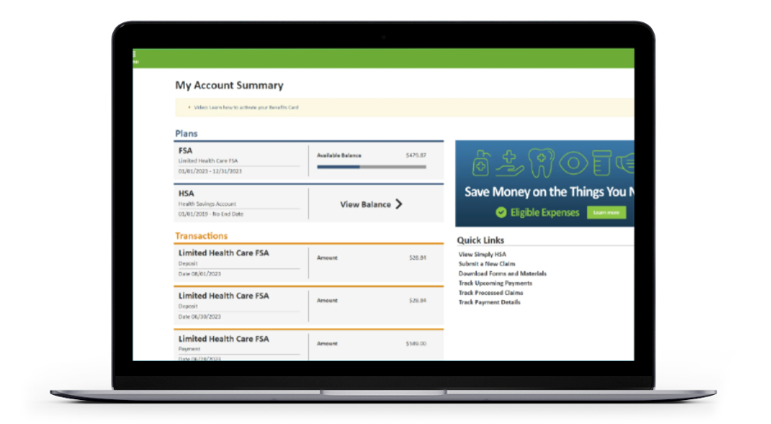
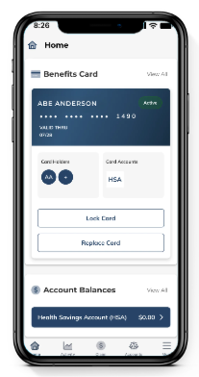
ONLINE ACCOUNT AND MOBILE
24/7 ACCESS TO YOUR ACCOUNT
01
Account Details
On your home page, click View Balance to access your HSA details.
02
Contributions
Visualize the deposits into your HSA and plan for future savings.
03
Transactions
View all of your HSA transactions in one place, both money in (contributions and interest earnings) and money out (disbursements, payments made from your HSA).
04
Investments
Manage HSA investments and access tools to build wealth and save for retirement.*
*Investment balance is view only in mobile app.
© Employee Benefits Corporation

Slide 20









If you receive a welcome communication and a Benefits Card, you passed the CIP and your HSA is officially open.
If you don't pass the initial CIP, you'll receive an email asking for additional documentation to verify your identity.
CUSTOMER IDENTIFICATION PROCESS (CIP)
Take immediate action. Your HSA cannot be opened or receive contributions until you pass the CIP.
To open a bank account, including an HSA, your identity must be verified under federal regulations. This adds security to your account and protects your personal information.
© Employee Benefits Corporation

Slide 21








GETTING STARTED WITH YOUR HSA
Set yourself up for success with these HSA best practices.
Set Up Your Online Account
Download
EBCentral App
Add
Beneficiaries
Learn more at ebcflex.com/HSAOnlineAccount
Download on the App Store® or Google Play.
Designate a beneficiary for your HSA in your online account.
Save Your Receipts
Access Statements & Tax Forms
Start Using Your HSA
It's a good idea to save health care bills and documentation in case of an IRS audit.
Use your Benefits Card to pay for eligible expenses directly from your HSA. Visit ebcflex.com/WheretoShop to learn more.
You can access statements and tax forms in your online account.
© Employee Benefits Corporation
Apple® and App Store® are registered trademarks of Apple Inc.
Google Play is a trademark of Google LLC.

Slide 22

ACCOUNT Consolidation
TAKE THE STEPS OUTLINED BY YOUR PREVIOUS CUSTODIAN TO CONSENT TO TRANSFER YOUR FUNDS
01.
02.
EASY MANAGEMENT
Manage one account and one debit card and reduce the number of tax-forms.
MAXIMIZE EARNED INTEREST
Earn more tax-free interest by consolidating account balances and using EBC's high-yield interest option.
03.
04.
NO EXTRA FEES
Consolidating HSAs reduces any unnecessary monthly administration fees often charged by individual HSAs.
MAXIMIZE INVESTMENTS
Consolidating HSA funds helps participants reach investment balance requirements quicker.
© Employee Benefits Corporation

Slide 23





Access resources online or
contact Participant Services for assistance.
GETTING
HELP
Online
Monday through Friday
7 a.m. to 7 p.m. Central Time
Log in to your account 24/7 at www.ebcflex.com
Email
participantservices@ebcflex.com
Phone
(800) 346-2126
© Employee Benefits Corporation | P4-8110 0925

