Slide 1


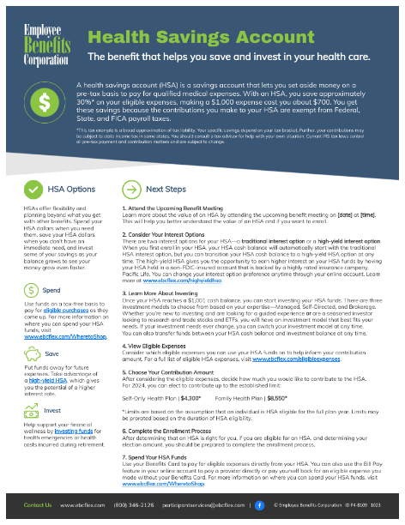

Instructions
Please ensure that you fill in details about upcoming benefit meetings [A] and delete these instructions before sharing the flyer with your employees.
A

Slide 2












Health Savings Account
The benefit that helps you save and invest in your health care.
A health savings account (HSA) is a savings account that lets you set aside money on a pre-tax basis to pay for qualified medical expenses. With an HSA, you save approximately 30%* on your eligible expenses, making a $1,000 expense cost you about $700. You get these savings because the contributions you make to your HSA are exempt from Federal, State, and FICA payroll taxes.
*This tax example is a broad approximation of tax liability. Your specific savings depend on your tax bracket. Further, your contributions may be subject to state income tax in some states. You should consult a tax advisor for help with your own situation. Current IRS tax laws control all pre-tax payment and contribution matters and are subject to change.
HSA Options
Next Steps
HSAs offer flexibility and planning beyond what you get with other benefits. Spend your HSA dollars when you need them, save your HSA dollars when you don’t have an immediate need, and invest some of your savings as your balance grows to see your money grow even faster.
1. Attend the Upcoming Benefit Meeting
Learn more about the value of an HSA by attending the upcoming benefit meeting on [date] at [time]. This will help you better understand the value of an HSA and if you want to enroll.
2. Consider Your Interest Options
There are two interest options for your HSA—a traditional interest option or a high-yield interest option. When you first enroll in your HSA, your HSA cash balance will automatically start with the traditional HSA interest option, but you can transition your HSA cash balance to a high-yield HSA option at any time. The high-yield HSA gives you the opportunity to earn higher interest on your HSA funds by having your HSA held in a non-FDIC-insured account that is backed by a highly rated insurance company, Pacific Life. You can change your interest option preference anytime through your online account. Learn more at www.ebcflex.com/highyieldhsa.
3. Learn More About Investing
Once your HSA reaches a $1,001 cash balance, you can start investing your HSA funds. There are three investment models to choose from based on your expertise—Managed, Self-Directed, and Brokerage. Whether you’re new to investing and are looking for a guided experience or are a seasoned investor looking to research and trade stocks and ETFs, you will have an investment model that best fits your needs. If your investment needs ever change, you can switch your investment model at any time.
You can also transfer funds between your HSA cash balance and investment balance at any time.
4. View Eligible Expenses
Consider which eligible expenses you can use your HSA funds on to help inform your contribution amount. For a full list of eligible HSA expenses, visit www.ebcflex.com/eligibleexpenses.
5. Choose Your Contribution Amount
After considering the eligible expenses, decide how much you would like to contribute to the HSA.
For 2025, you can elect to contribute up to the established limit:
Self-Only Health Plan | $4,300* Family Health Plan | $8,550*
*Limits are based on the assumption that an individual is HSA eligible for the full plan year. Limits may be prorated based on the duration of HSA eligibility.
6. Complete the Enrollment Process
After determining that an HSA is right for you, if you are eligible for an HSA, and determining your election amount, you should be prepared to complete the enrollment process.
7. Spend Your HSA Funds
Use your Benefits Card to pay for eligible expenses directly from your HSA. You can also use the Bill Pay feature in your online account to pay a provider directly or pay yourself back for an eligible expense you made without your Benefits Card. For more information on where you can spend your HSA funds, visit www.ebcflex.com/WheretoShop.
Spend
Use funds on a tax-free basis to pay for eligible purchases as they come up. For more information on where you can spend your HSA funds, visit www.ebcflex.com/WheretoShop.
Save
Put funds away for future expenses. Take advantage of a high-yield HSA, which gives you the potential of a higher interest rate.
Invest
Help support your financial wellness by investing funds for health emergencies or health costs incurred during retirement.
Contact Us www.ebcflex.com (800) 346-2126 participantservices@ebcflex.com |
© Employee Benefits Corporation ID P4-8109 0525

