Slide 1



Flexible Spending
Accounts
© Employee Benefits Corporation

Slide 2

IMPORTANT INSTRUCTIONS
THIS IS A CUSTOMIZABLE PRESENTATION. Please carefully review the information and fill in the placeholder slots in the slides as it applies to your plan.
Specifically, review the following:
Plan Limits: Fill in your contribution limits for the applicable plan(s) that you offer (health care and/or dependent care). You should also fill in the dates of your plan year.
Runout Period / Grace Period / Rollover: Fill in the applicable slides with the correct dates and which plans the corresponding slide refers to. Please delete the slides that are not applicable.
Eligible Expenses: Remove the slides for account types you don't offer. There are slides for health care, limited health, and dependent care FSA
Once you're done customizing the slides, please delete this instruction slide prior to presenting.

Slide 3






Health Care FSA
Pay for eligible medical, vision, and dental expenses that are not covered by another health plan.
Limited Health FSA
Pay for eligible vision and dental expenses that are not covered by another health plan.
Dependent Care FSA
Flexible Spending Accounts
Set aside pre-tax funds to pay for daycare expenses for children or other eligible dependents
An FSA is an account that allows you to set aside pre-tax funds to pay for eligible expenses.
© Employee Benefits Corporation

Slide 4


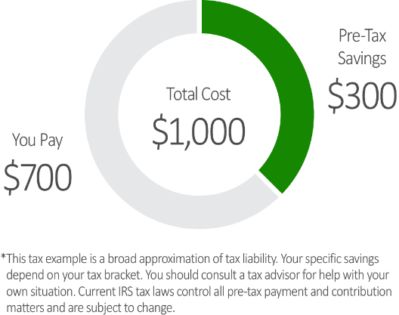

FSA Savings
tax savings on eligible purchases
With an FSA, you save approximately 30%* on your eligible expenses, making a $1,000 expense cost you about $700.
© Employee Benefits Corporation

Slide 5






FSA
CONTRIBUTION
LIMITS
HEALTH CARE
DEPENDENT
dEPENDENT
$X,XXX
$X,XXX*
$X,XXX*
YOU choose how much of YOUR pay to place in the Fsa
(up to the IRS Maximum)
Standard Health FSA
Limited Health FSA
Married Filing Separate
Single
Married Filing Joint
Plan dates:
XX/XX/202X - XX/XX/202X
*Limit may be lower depending on individual circumstances.
© Employee Benefits Corporation

Slide 6

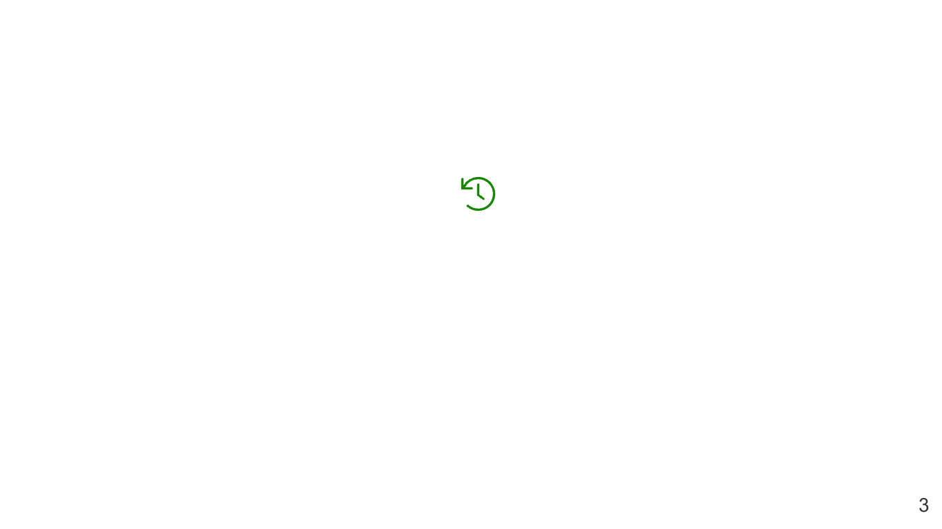

RUNOUT PERIOD
planning WHEN FUNDS MUST BE USED
Allows extra time to submit claims for eligible expenses incurred during the plan year. The runout period applies to the health care / dependent care FSA.
Runout Period Dates: Claims must be submitted by XX/XX/202X
© Employee Benefits Corporation

Slide 7


GRACE PERIOD
planning WHEN FUNDS MUST BE USED
Gives an additional period of time to incur claims after the end of the plan year. The grace period applies to the health care / dependent care FSA.
Grace Period Dates: Claims must be incurred by XX/XX/202X.
© Employee Benefits Corporation

Slide 8

ROLLOVER
planning WHEN FUNDS MUST BE USED
Allows up to $X,XXX to roll from one plan year to the next from the health care FSA.
© Employee Benefits Corporation

Slide 9

HEALTH CARE FSA EXPENSES
VISIT WWW.EBCFLEX.COM/ELIGIBLEEXPENSES FOR A MORE COMPREHENSIVE LIST
Dental expenses
Lab exams/tests
Vision expenses
Medical treatments / procedures
Copays, coinsurance, deductible expenses
Over-the-counter (OTC) medications and products
Medical supplies and services
© Employee Benefits Corporation

Slide 10



LIMITED HEALTH FSA EXPENSES
VISIT WWW.EBCFLEX.COM/ELIGIBLEEXPENSES FOR A MORE COMPREHENSIVE LIST
Dental Expenses
Vision Expenses
© Employee Benefits Corporation

Slide 11




DEPENDENT CARE FSA EXPENSES
VISIT WWW.EBCFLEX.COM/ELIGIBLEEXPENSES FOR A MORE COMPREHENSIVE LIST
Child Care Expenses
Adult Care Expenses
© Employee Benefits Corporation

Slide 12




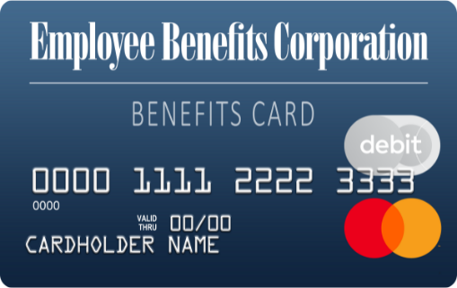


USING YOUR BENEFITS CARD
Swipe, Tap, or Type
Simply swipe the card, use it to pay online, or add it to your digital wallet* and use it wherever Apple Pay®, Google Pay, and Samsung Pay are accepted.
Where to Shop
Shop where you normally do, or check out an online retailer that specializes in FSA-eligible products. Visit ebcflex.com/WheretoShop to learn more.
Request Additional Cards
Request up to five additional cards for eligible users through your online account or the EBCentral app.
*Only available to primary cardholders
Apple® and Apple Pay® are registered trademarks of Apple Inc.
Google Pay is a trademark of Google LLC.
Samsung and Samsung Pay are trademarks of Samsung Electronics Co., Ltd.
© Employee Benefits Corporation

Slide 13








submitting claims for reimbursement
You can submit claims to be reimbursed for expenses you pay out-of-pocket.
EBCentral app
Use your online account information to log in and submit a claim or upload documentation. EBCentral is available on the App Store® or Google Play.
Online account
Log in at www.ebcflex.com to submit a claim and upload documentation.
enroll in direct deposit
The quickest way to receive reimbursement is to sign up for direct deposit. Sign up through the EBCentral mobile app.
Apple® and App Store® are registered trademarks of Apple Inc.
Google Play is a trademark of Google LLC.
© Employee Benefits Corporation

Slide 14




Why It's Necessary
EBC is required to verify the eligibility of every Benefits Card transaction under IRS regulations with no exceptions.
Notification Process
If a Benefits Card transaction cannot be auto-substantiated, you will receive an email alert that you must submit documentation.
documentation requests
Submitting Documentation
The fastest way to submit documentation is through the EBCentral app or by logging in to your online account at www.ebcflex.com.
What to expect
© Employee Benefits Corporation
© Employee Benefits Corporation
© Employee Benefits Corporation

Slide 15




documentation requests
BEST PRACTICES
Always save your receipts
Use EBCentral App or your online account
Contact EBC with questions
Be prepared to substantiate claims by saving your itemized receipts for all Benefits Card transactions.
Easily upload documentation online, or use your phone's camera and upload to the EBCentral mobile app.
Participant Services
(800) 346-2126
participantservices@ebcflex.com
© Employee Benefits Corporation

Slide 16
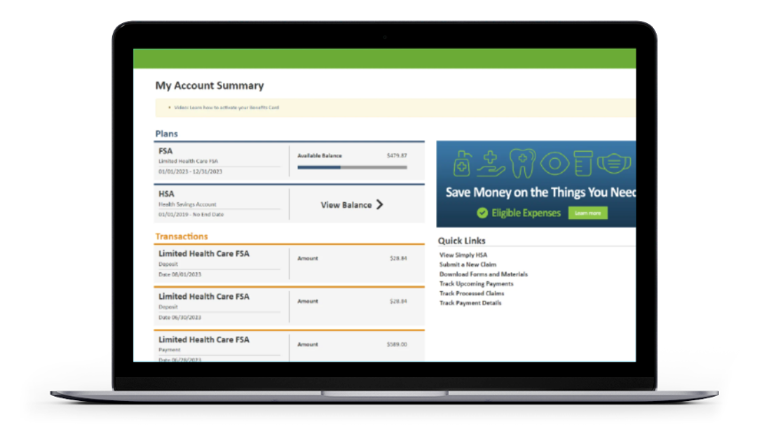
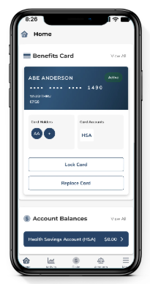
ONLINE RESOURCES
01
Online Account
Easily access account information, forms and materials, submit claims and documentation, and more! Visit www.ebcflex.com to log in.
02
Mobile App
EBCentral makes it easy for participants to access account information, submit claims and documentation, manage their Benefits Cards, and more.
03
Eligible Expenses
To get an idea of what types of expenses you can spend your FSA funds on, visit www.ebcflex.com/eligibleexpenses.
04
Where to Shop
Shop where you normally buy eligible items, or check out an online retailer that specializes in FSA eligible products. Visit www.ebcflex.com/WheretoShop to learn more.
© Employee Benefits Corporation

Slide 17






GETTING STARTED WITH YOUR FSA
Set yourself up for success with these FSA best practices.
Set Up Your Online Account
Download
EBCentral App
Set Up
Direct Deposit
This is the easiest way to manage your benefits. To learn more about setting it up, visit ebcflex.com/FSAOnlineAccount.
Download on the App Store® or Google Play. Use your existing online account info or register for a new account.
The quickest way to receive reimbursement is to sign up for direct deposit. Sign up through your online account.
Add an
Authorized User
Start Using
Your FSA
Filling out this form allows the specified person to ask questions about your accounts. Find the form at ebcflex.com/forms.
Sometimes we require documentation to verify your expense. Don't forget to save
your receipts!
Apple® and App Store® are registered trademarks of Apple Inc.
Google Play is a trademark of Google LLC.
© Employee Benefits Corporation

Slide 18





Access resources online or
contact Participant Services for assistance.
GETTING
HELP
Online
Monday through Friday
7 a.m. to 7 p.m. Central Time
Log in to your account 24/7 at www.ebcflex.com
Email
participantservices@ebcflex.com
Phone
(800) 346-2126
© Employee Benefits Corporation | P2-8110 1125

