Slide 1



Commuter
Benefits
© Employee Benefits Corporation

Slide 2

IMPORTANT INSTRUCTIONS
THIS IS A CUSTOMIZABLE PRESENTATION. Please carefully review the information to ensure only information regarding the plan you're offering is provided.
If you are only offering parking or transit, only keep the information on that account type in the presentation. Account specific information can be found on the following slides: slide 3 and slide 5.
Once you're done customizing the slides, please delete this instruction slide prior to presenting.

Slide 3





Transit Account
Pay for eligible transit expenses to and from the workplace. Eligible transit expenses are defined as passes, tokens, fare cards, vouchers, or similar items for:
Mass transit (such as the train, bus, subway, or ferry)
Commuter highway vehicles
Parking Account
Pay for work related parking expenses.
At or near your regular place of employment
At a location from which you commute to work by carpool, commuter highway vehicle, or mass transit
COMMUTER
Benefits
a money saving transportation plan
© Employee Benefits Corporation

Slide 4

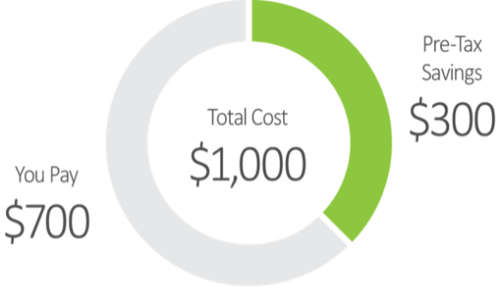


commuter Savings
tax savings on eligible transportation expenses
With a commuter account, you save approximately 30%* on your eligible expenses, making $1,000 commuter expenses cost you about $700.
*This tax example is a broad approximation of tax liability. Further, your contributions may be subject to state income tax in some states. Your specific savings depend on your tax bracket. You should consult a tax advisor for help with your own situation. Current IRS tax laws control all pre-tax payment and contribution matters and are subject to change.
© Employee Benefits Corporation

Slide 5





2026 COMMUTER ACCOUNT LIMITS
YOU choose how much of YOUR pay to place in the ACCOUNT
(up to the IRS Maximum)
Transit
Parking
$340
$340
MONTHLY
MONTHLY
© Employee Benefits Corporation
© Employee Benefits Corporation

Slide 6


MONTHLY CONTRIBUTION CYCLE
CHOOSE YOUR CONTRIBUTION OPTION BASED ON WHETHER YOUR EXPENSES ARE EXPECTED TO BE
THE SAME EACH MONTH OR NOT
RECURRING
ONE-TIME
Set your contribution once and forget it
Contributions must be set by the 13th of the month - your contributions will be made available the month after it was scheduled
Unused funds roll from month-to-month
Receive email alerts of the upcoming contribution so you have a chance to make edits
Manually choose what your contribution for the upcoming month will be
Contributions must be set by the 13th of the month - your contributions will be made available the month after it was scheduled
Unused funds rollover from month-to-month
BEST IF MONTHLY EXPENSES ARE THE SAME
bEST IF MONTHLY EXPENSES CHAnge
If you do not have the contribution management functionality set up in your online account, contact your employer on how to manage your contributions through their benefit management system.

Slide 7



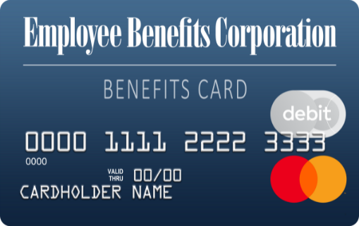



USING YOUR BENEFITS CARD
Swipe
Simply swipe your card how you would use other debit cards to pay for your eligible transportation expenses.
Use Online
If you pay for eligible expenses online, access your funds by entering your card details online.
Mobile Pay
Primary cardholders can add the Benefits Card to their digital wallet to ensure seamless payments for commuter expenses when contactless transactions are required.
© Employee Benefits Corporation

Slide 8
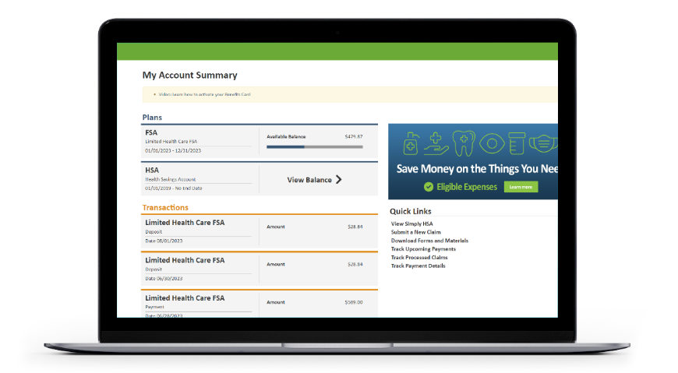
ONLINE RESOURCES
01
Online Account
Easily access account information, forms and materials, submit claims, and more! Visit www.ebcflex.com to log in.
02
ebcflex.com/commuter
Information about how to manage and use your commuter benefits can be found at www.ebcflex.com/commuter. Here you'll find helpful videos and more.
03
Mobile App
EBCentral makes it easy to control your Benefits Card. Lock a card if it goes missing and unlock it when it is found or request a replacement card.
04
Eligible Expenses
To get an idea of what types of expenses you can spend your Commuter funds on, visit www.ebcflex.com/eligibleexpenses.
© Employee Benefits Corporation

Slide 9





GETTING STARTED WITH
COMMUTER BENEFITS
Set yourself up for success with these commuter best practices.
Set Up Your Online Account
Add the Benefits Card to Your Digital Wallet
Add an
Authorized User
Start Managing Your Contributions
This is the easiest way to manage your benefits. To learn more, visit ebcflex.com/commuter.
Primary cardholders can add the Benefits Card to their digital wallet to securely pay with their phone.
Filling out this form allows the specified person to ask questions about your accounts. Find the form at ebcflex.com/forms.
Set your contributions by the 13th of the month prior to when you want to use your funds.
© Employee Benefits Corporation

Slide 10





Access resources online or
contact Participant Services for assistance.
GETTING
HELP
Online
Monday through Friday
7 a.m. to 7 p.m. Central Time
Log in to your account 24/7 at www.ebcflex.com
Email
participantservices@ebcflex.com
Phone
(800) 346-2126
© Employee Benefits Corporation | P6-8110 0925

