Slide 1


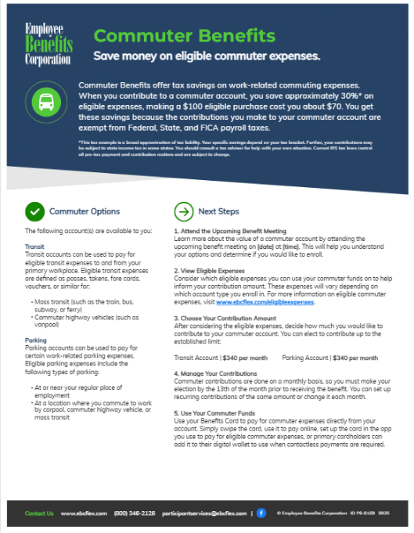

Instructions
Please ensure that you remove the commuter accounts that you aren’t offering [A], input details about upcoming benefit meetings [B], and delete these instructions before sharing the flyer with your employees.
B
A

Slide 2









Commuter Benefits
Save money on eligible commuter expenses.
Commuter Benefits offer tax savings on work-related commuting expenses. When you contribute to a commuter account, you save approximately 30%* on eligible expenses, making a $100 eligible purchase cost you about $70. You get these savings because the contributions you make to your commuter account are exempt from Federal, State, and FICA payroll taxes.
*This tax example is a broad approximation of tax liability. Your specific savings depend on your tax bracket. Further, your contributions may be subject to state income tax in some states. You should consult a tax advisor for help with your own situation. Current IRS tax laws control all pre-tax payment and contribution matters and are subject to change.
Commuter Options
Next Steps
The following account(s) are available to you:
Transit
Transit accounts can be used to pay for eligible transit expenses to and from your primary workplace. Eligible transit expenses are defined as passes, tokens, fare cards, vouchers, or similar for:
Mass transit (such as the train, bus, subway, or ferry)
Commuter highway vehicles (such as vanpool)
Parking
Parking accounts can be used to pay for certain work-related parking expenses. Eligible parking expenses include the following types of parking:
At or near your regular place of employment
At a location where you commute to work by carpool, commuter highway vehicle, or mass transit
1. Attend the Upcoming Benefit Meeting
Learn more about the value of a commuter account by attending the upcoming benefit meeting on [date] at [time]. This will help you understand your options and determine if you would like to enroll.
2. View Eligible Expenses
Consider which eligible expenses you can use your commuter funds on to help inform your contribution amount. These expenses will vary depending on which account type you enroll in. For more information on eligible commuter expenses, visit www.ebcflex.com/eligibleexpenses.
3. Choose Your Contribution Amount
After considering the eligible expenses, decide how much you would like to contribute to your commuter account. You can elect to contribute up to the established limit:
Transit Account | $340 per month Parking Account | $340 per month
4. Manage Your Contributions
Commuter contributions are done on a monthly basis, so you must make your election by the 13th of the month prior to receiving the benefit. You can set up recurring contributions of the same amount or change it each month.
5. Use Your Commuter Funds
Use your Benefits Card to pay for commuter expenses directly from your account. Simply swipe the card, use it to pay online, set up the card in the app you use to pay for eligible commuter expenses, or primary cardholders can add it to their digital wallet to use when contactless payments are required.
Contact Us www.ebcflex.com (800) 346-2126 participantservices@ebcflex.com |
© Employee Benefits Corporation ID P6-8109 0925

