Slide 1



Claims Submission
& Documentation
© Employee Benefits Corporation
Notes:
Note title
Type your notes here. They will be viewable in presenter view.

Slide 2




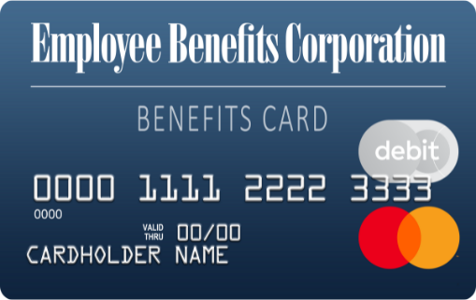


USING YOUR BENEFITS CARD
Swipe, Tap, or Type
Simply swipe the card, use it to pay online, or add it to your digital wallet* and use it wherever Apple Pay®, Google Pay, and Samsung Pay are accepted.
Where to Shop
Shop where you normally do, or check out an online retailer that specializes in FSA-eligible products. Visit ebcflex.com/WheretoShop to learn more.
Request Additional Cards
Request up to five additional cards for eligible users through your online account or the EBCentral mobile app.
*Only available to primary cardholders
Apple® and Apple Pay® are registered trademarks of Apple Inc.
Google Pay is a trademark of Google LLC.
Samsung and Samsung Pay are trademarks of Samsung Electronics Co., Ltd.
© Employee Benefits Corporation

Slide 3








submitting claims for reimbursement
You can submit claims to be reimbursed for expenses you pay out-of-pocket.
EBCentral app
Use your online account information to log in and submit a claim or upload documentation. EBCentral is available on the App Store® or Google Play.
Online account
Log in at www.ebcflex.com to submit a claim and upload documentation.
enroll in direct deposit
The quickest way to receive reimbursement is to sign up for direct deposit. Sign up through the EBCentral mobile app.
Apple® and App Store® are registered trademarks of Apple Inc.
Google Play is a trademark of Google LLC.
© Employee Benefits Corporation

Slide 4






Why It's Necessary
EBC is required to verify the eligibility of every Benefits Card transaction under IRS regulations with no exceptions.
Notification Process
If a Benefits Card transaction cannot be auto-substantiated, you will receive an email alert that you must submit documentation.
documentation requests
Submitting Documentation
The fastest way to submit documentation is through the EBCentral app or by logging in to your online account at www.ebcflex.com.
What to expect
© Employee Benefits Corporation
© Employee Benefits Corporation
© Employee Benefits Corporation

Slide 5




documentation requests
BEST PRACTICES
Always save your receipts
Use EBCentral App or your online account
Contact EBC with questions
Be prepared to substantiate claims by saving your itemized receipts for all Benefits Card transactions.
Easily upload documentation online, or use your phone's camera and upload to the EBCentral mobile app.
Participant Services
(800) 346-2126
participantservices@ebcflex.com
© Employee Benefits Corporation

Slide 6
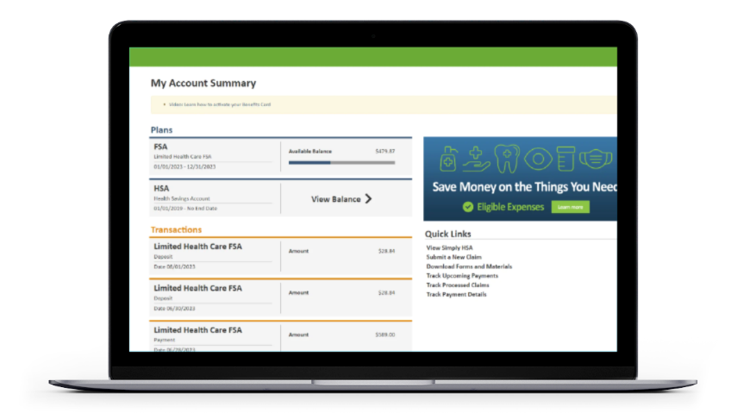
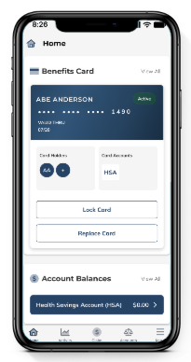
ONLINE RESOURCES
01
Online Account
Easily access account information, forms and materials, submit claims and documentation, and more! Visit www.ebcflex.com to log in.
02
Mobile App
EBCentral makes it easy for participants to access account information, submit claims and documentation, manage their Benefits Cards, and more.
03
Eligible Expenses
To get an idea of what types of expenses you can spend your FSA funds on, visit www.ebcflex.com/eligibleexpenses.
04
Where to Shop
Shop where you normally buy eligible items, or check out an online retailer that specializes in FSA eligible products. Visit www.ebcflex.com/WheretoShop to learn more.
© Employee Benefits Corporation

Slide 7





Access resources online or
contact Participant Services for assistance.
GETTING
HELP
Online
Monday through Friday
7 a.m. to 7 p.m. Central Time
Log in to your account 24/7 at www.ebcflex.com
Email
participantservices@ebcflex.com
Phone
(800) 346-2126
© Employee Benefits Corporation | P2-8116 0925

